Slide 1

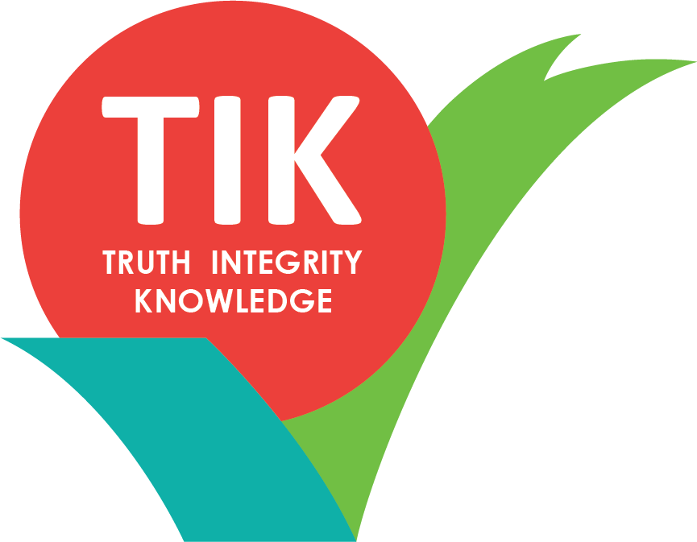

#QLDCritLib
Disruptive Discussions:
A day of critical librarianship

Slide 2
Disruptive Discussions:
A day of critical librarianship
It’s Our Moral Obligation
James Nicholson
@JamesNicholson1
#QLDCritLib
Notes:
Hi everyone. My name is James Nicholson and I’m the ALIA State Manager for QLD. I also work in Scholarly Publishing at the University of Queensland. I would like to begin by acknowledging the Traditional Owners of land upon which we meet today, and recognise their continuing connection to land, waters and culture. I pay my respects to their Elders past, present and emerging.
The conversations we will have today should be confronting, they should be difficult, there’s no easy answer and we may very well need to change our opinions or assumptions. But this should never stop us from having these conversations. It’s simply not good enough for us to say that we are scared of offending someone or worried you might make a mistake. Let’s listen, then ask, then listen again. Finally let’s act.
This is only a short presentation, but I wanted to offer a look at what critical librarianship is and what it could look like in practice. My presentation will have a number of quotes which is because there are experts that demonstrate points far better than I. There is a huge amount of content out there coming at Crit Lib from many different angles, I’ll try and draw out some points but I’ll have a large reference list at the end and send these slides around afterwards so you can do some further reading if you want to.

Slide 3
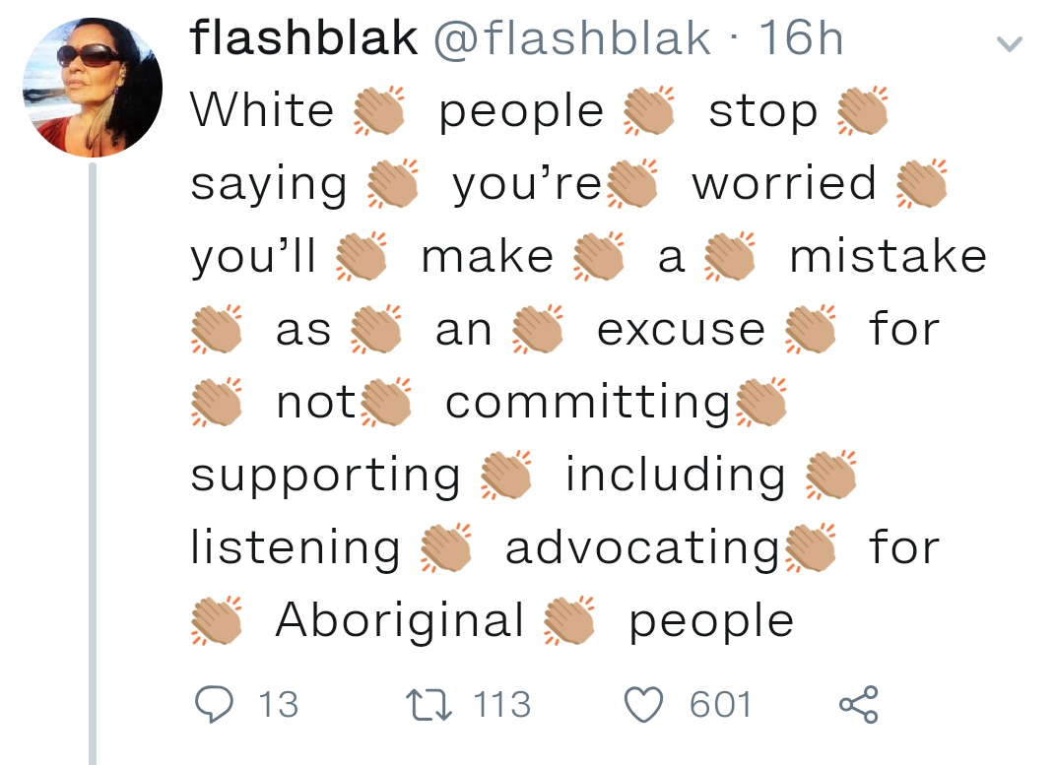
#QLDCritLib
Notes:
We will make mistakes along the way, but there is an amazing pool of experience, knowledge and passion in this room to help all of us in these discussions. Because today we should all be challenged, but we are not being disrespected. To me, today is about tearing down barriers, ideologies, stereotypes, broken policy and procedure, and building relationships, understanding and respect.
I can assure you that this short presentation is very scary. Whilst I would consider myself extroverted in a social setting, talking critical librarianship on social justice topics to a room of very knowledgeable people that I have come to admire and respect in various ways is waaaay outside my comfort zone.
But this tweet sums up a message that I also heard out of our leadership and innovation forum we did last year, however I think it can be applied to all the areas and topics we’re going to discuss today. Its what drives me to stand here now, because I don’t have the experience and knowledge some of you have, but I do have something to contribute as we all do, I’m passionate about the topics we’ll be discussing and for me this was a chance to engage, which is why its so awesome to see you all here today.

Slide 4

Speak Out!
Be disruptive and respectful
What’s said here
DOESN’T stay here!!
#QLDCritLib
Notes:
Before I go any further I wanted to just mention a couple of points. With all I've just said about making mistakes, we want you to SPEAK OUT!
Be disruptive and respectful!
Let’s also make sure what's said here today DOESNT stay here today. We need to think today about how we take what we talk about and apply it in our work places and how we develop policy, procedure but also how we look to change our own attitudes towards the work we do and the actions we take. And by doing this we will inspire those around us to make change

Slide 5
Am I really hearing these people
Am I doing all I can to challenge the status quo
#QLDCritLib
Notes:
Sam Popowich says to him Critical librarianship must be both the critic of institutions and practices, and a practice of solidarity to those who, as marginalised groups, may find it difficult or impossible to speak or act in opposition to the status quo.
I have a challenge for us all.
I challenge you over the course of today to ask yourself the following questions: Am I really hearing these people, (and I don’t mean just stood in front of, but truly heard what they have said), and am I doing all I can to challenge the status quo. Now this isn’t some competition of grand gestures, but rather an internal reflection on what your capacity to help, challenge or be disruptive is, as its different for all of us but all equally important.

Slide 6

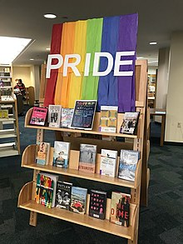
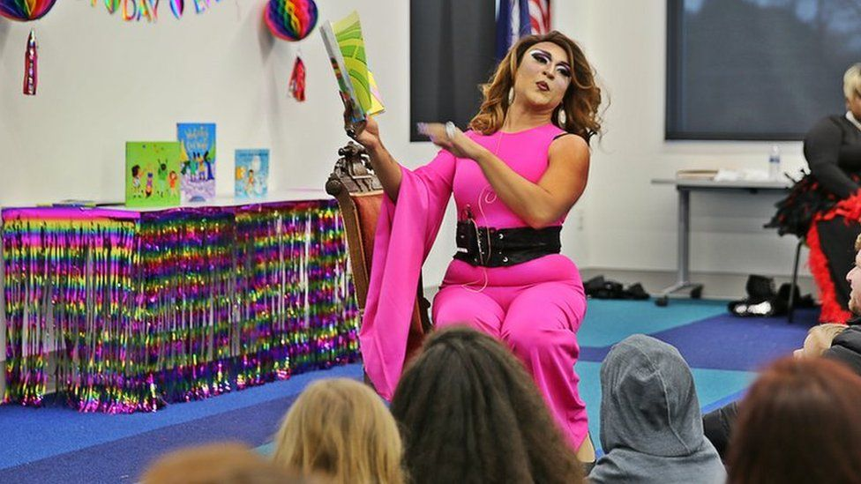
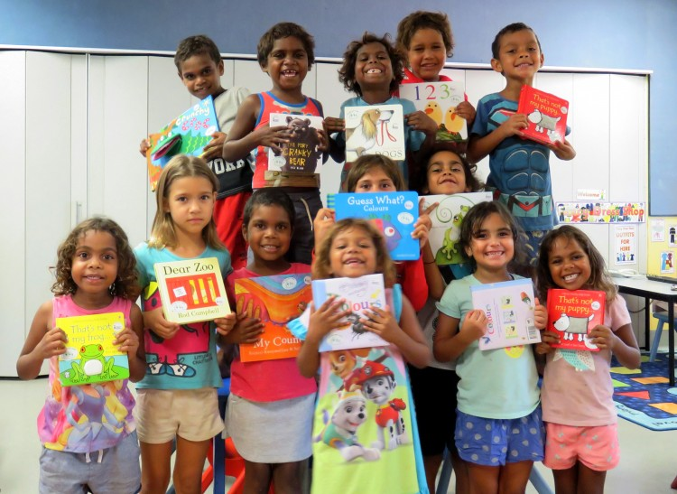
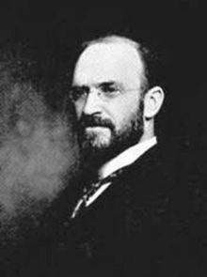
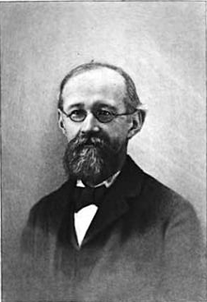
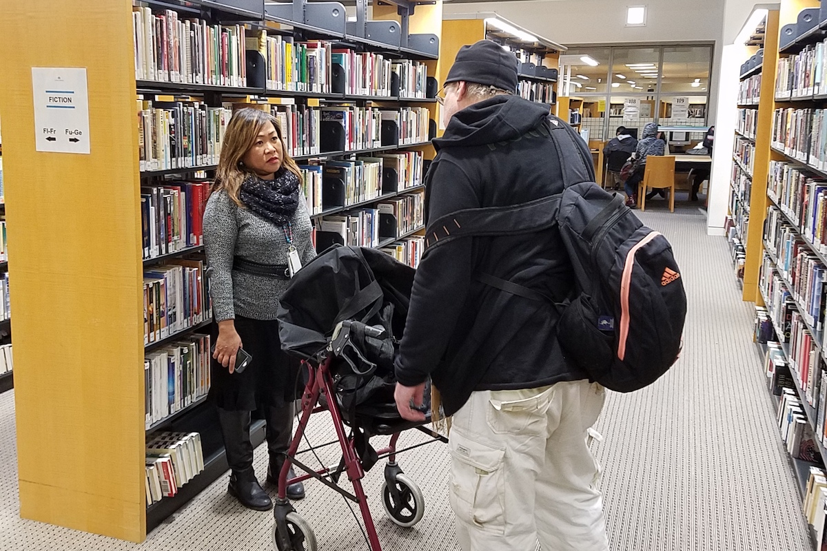
Notes:
So we come to the question, what exactly IS critical librarianship. In many ways this is the hardest point to start at because critical librarianship can mean different things to different people, it can also change in context and over time.
I will begin with Kelly McElroy and her article ‘But how do we DO critical librarianship’ when she says that “critical librarianship asks us to look at the socio-political world both inside and outside our libraries.”
We might also look to Meridith Farkas who says in her article ‘Never Neutral’ that “Critical Librarianship supports the belief that, in our work as librarians, we should examine and fight attempts at social oppression.”
What is the libraries role?
Well we will unpack that further today, but what I believe will emerge as evident is that there seems to be an urgent, or critical need for critical librarianship. So this is the first sense that we might see the word critical. How else might we unpack the word critical. Well there is no doubt about the connections to theory; critical theory, critical literacy and critical pedagogy, albeit distinct but connected areas. We might also see critical in the sense of being critical of, or criticising something. The problem here though is that it creates an image of critical librarians waiting to tear down the status quo at all costs with the otherside trying to hold it up. Diametrically opposed, but neither building a future.
So I think its useful today to take elements from all these associations with the word critical whilst remembering that we are moving past awareness and into social justice. This requires doing. I'm going to discuss what critical librarianship in practice might look like, in a minute.

Slide 7
Why is critical librarianship important?
#QLDCritLib
Notes:
The topic of this slide, ‘Why is crit lib important’ might seem at first to be self evident. But I think its important that we actually to take a second to unpack why we are here today, why are we thinking about these topics, why even bother?
This slide actually took me the longest time to write out of all my slides. But there's nothing on it James! Great observation, but its intentional. I realised I didn’t know the answer. Sure I had a mountain of literature, articles blogs and so on but there are people here in this room that know the answer because they’ve felt it, they’ve experienced it. The true reason critical librarianship and standing up to social injustice is important must be told by those that have experienced social injustice, those that we can support and those who have the experiences to teach us all.
So I want to park this slide and come back to it, at the end after we’ve all listened, challenged and discussed I think we will have a truer understanding of why its important, and our motivation to act will be stronger for it.

Slide 8
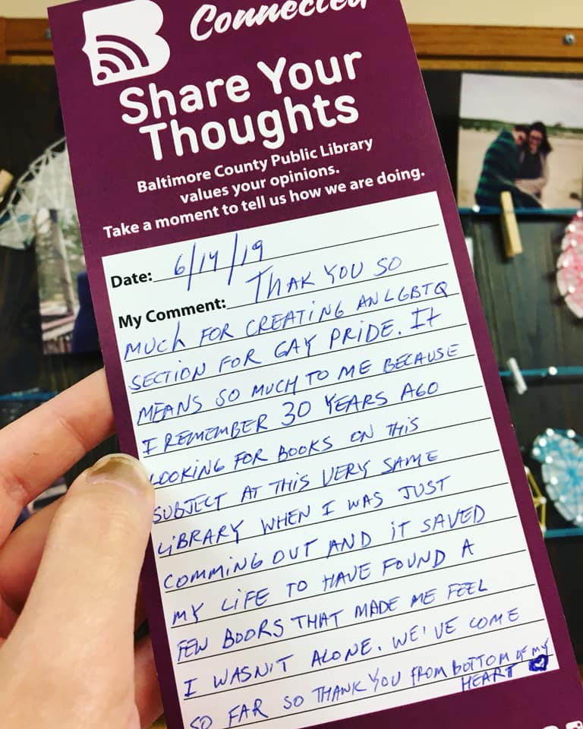
https://www.facebook.com/photo.php?fbid=10219956012511088&set=a.2655898677127&type=3&theater&ifg=1
#QLDCritLib
Notes:
However, there was one piece of content that I stumbled across that I wanted to include under the section of importance. I'm not sure it fits but it’s such a true and important feeling from a patron of the Baltimore County Public Library.
It was Taken from the ALA think tank FB site just this last week.
Thank you so much for creating an LGBTQ section for Gay Pride. It means so much to me because I remember 30 years ago looking for books on this subject at this very same library when I was just coming out and it saved my life to have found a few books that made me feel I wasn’t alone, we’ve come so far, so thank you (from the bottom of my heart).

Slide 9
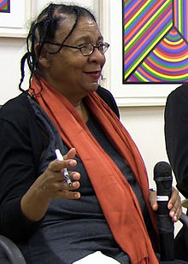
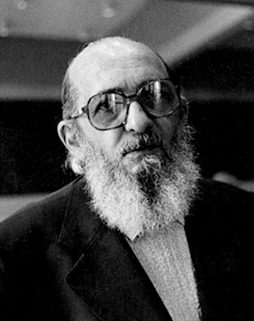
And friends…
Henry Giroux
James Elmborg
Peter McLaren
Shirley Steinberg
Antonia Darder
Bell Hooks
Image: https://en.wikipedia.org/wiki/Bell_hooks
Paolo Freire
Image: https://en.wikipedia.org/wiki/Paulo_Freire
#QLDCritLib
Notes:
So we’ve talked a little about what crit lib is, and talked about its importance even though we’ll come back to fill in some of the blanks. But what about some of the theory behind critical librarianship. I also thought long and hard about how to fit a hundred years of progressive librarianship covering aspects of critical pedagogy, critical literacy, Queer Theory, Critical disability studies and others coupled with key texts from influential theorists, activists, commentators and speakers into a few minutes, and obviously its impossible. Rather I will point out some theorists and some articles as a starting point and offer homework for the coming days.
Some theorists you would see mentioned a lot include Bell Hooks, Paolo Freire (free-ree), Henry Giroux, James Elmborg and others. Ive added a little list hear so you can read their work if you wish.

Slide 10
Articles to get you started:
  1. Never Neutral - Meredith Farkas
  2. But How Do We Do Critical Librarianship - Kelly McElroy
  3. Queering the Catalog: Queer Theory and the Politics of Correction - Emily Drabinski
  4. Critical Information Literacy: Implications for Instructional Practice - James Elmborg
#QLDCritLib
Notes:
The articles I have on this slide are very accessible and a great entry point into reading about critical librarianship.
Some interesting articles to get you started too.
Never Neutral – Meredith Farkas
But How Do We Do Critical Librarianship – Kelly McElroy
Queering the Catalog: Queer Theory and the Politics of Correction – Emily Drabinski
Critical Information Literacy: Implications for Instructional Practice – James Elmborg
Critical librarianship can be described as the application of various critical methodologies, to the study and practice of librarianship. However, I want to focus on a move to praxis from theory. I mean, that’s why we have a room of committed, passionate people here on a weekend. We are here to inform our practice but also, hopefully, take something away to put into practice. Examples of this move to doing can be seen through avenues such as the CritLib hashtag community on Twitter that I will talk about soon but also grass roots campaigns like librarians for refugees or library programs like drag queen story time, or as we saw in the last slide, a simple LGBTQ book display for Gay Pride.

Slide 11
“A commitment to social justice is a commitment to equal access, which is at the heart of our professional values. We are not being neutral when we advocate for our patrons, but we are being good librarians.”
Meredith Farkas (2017)
Farkas, M. 2017, ‘Never Neutral’, American Libraries, vol. 48, no.1, pp.70.
#QLDCritLib
Notes:
But what does it have to do with you. After all, you work in a library and libraries are neutral. Well as you probably know I argue otherwise and Meredith Farkas from her article ‘Never Neutral’ sums it up well for me.
“A commitment to social justice is a commitment to equal access, which is at the heart of our professional values. We are not being neutral when we advocate for our patrons, but we are being good librarians.”
I wont go into library neutrality here, I just wanted to quickly touch on it to bring it into our minds, simply because it will be one of the breakout topics so we can discuss it in detail then.

Slide 12
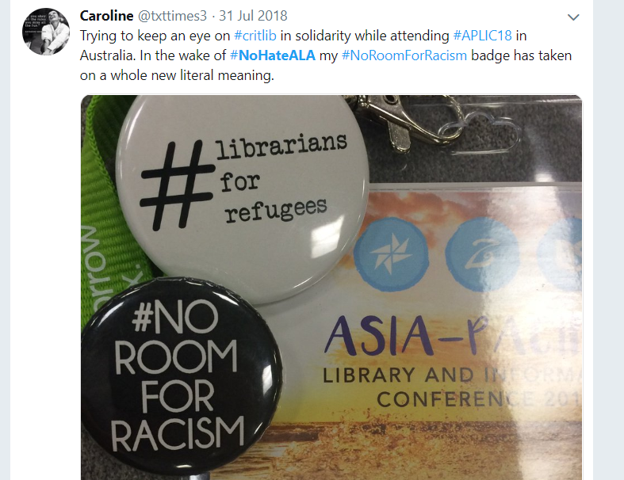
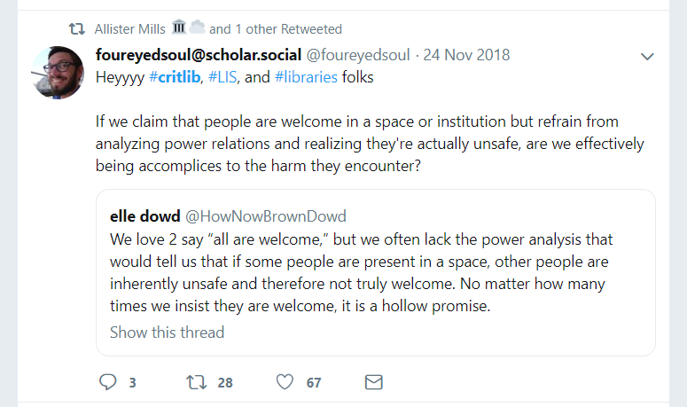
#critlib
#QLDCritLib
Notes:
So as we begin to move from theory to praxis we should stop by the Crit Lib hashtag online community. For those unfamiliar it’s an online community built around a hashtag concerning critical librarianship.
Origins can be traced back to a Twitter chat that took place in April 2014 although progressive librarianship dates back many years before this. Nora Almeida writes that as a symbol, the #critlib hashtag evokes a dispersed collective of librarians who ascribe to a certain shared values that inform their work in libraries. By embracing a ‘critical’ stance against bureaucracy, social injustice, and homogenous (hoe modge enous) ideological identity, the critlib hashtag also functions as an oppositional rhetorical (re torical) and performative strategy.
I don’t want to get bogged down here because there are distinctions between the Crit lib hashtag, progressive librarianship and critical librarianship, as well as differences between the crit lib hashtag critical literacy, critical pedagogy and so on. What I want to mention is what the crit lib hashtag community looks like today. Here are a few tweets from the last month or two to demonstrate the collective resource sharing, provoking, challenging, connecting movement it is.
And from this community we can move into praxis. Into the doing. Inspired by, instructed, aided and support through the critlib community, members can act in a variety of ways and I'm going to discuss the doing part next.

Slide 13
What are we going to do about it ?
#QLDCritLib
Notes:
As we’ve mentioned before Critical Librarianship can mean a number of things. There's no singular or right way to approach it. Critical Librarianship can take many forms. It may seem difficult at first to know where to start, there's no tick box list. What we need to remember is that we can not sit by and do nothing. We can always improve our attitudes, our practice, our systems and our libraries.
We have a community of knowledgeable and experienced people to draw on, just in this room alone. So utilise this. Listen and hear what's being said.
In the real world we can see critical librarianship played out at events like this, in conference presentations, hosting LGBTQI+ storytime programs, bringing social services for the homeless into the library space so there is a one stop shop for help. It might mean reviewing the picture books in the collection to see the gender or race balance of lead characters or hosting a teen book club exploring social identities.
This whole event will be about discussing these things but just know that Critical Librarianship takes many forms but there are always people to learn from and there is space for everyone.
This quote was taken from Nora Almeida’s 2018 article ‘Interrogating the Collective: #Critlib and the Problem of Community’ :
“But today, in libraries and universities, critical librarians are pushing back against institutional and cultural oppression in the small strategic ways they can.
Some of them will get on Twitter to share their experiences or to organize and some of them will contribute to the growing body of scholarship about critical librarianship.
Some of them will introduce a new idea at a library conference or start a conversation with a colleague in the stacks of their own library. Collectively, these librarians will develop new ways to think and talk about what librarianship is and does and should do. “
I believe that even the smallest acts of defiance against any oppressive system, or pockets of concerted effort to break social injustice, will pay off over time.

Slide 14
Speak out! We’re not here to tear each other down, we’re here to learn, challenge and act
Libraries cannot be/are not, neutral
We are here to build a better future
#QLDCritLib
Notes:
So with that in mind I will say a few last points.
Speak out! We’re not here to tear each other down, we’re here to listen, learn, challenge and act
Libraries cannot be neutral, they are laced with normative structures and dominant ideologies. Libraries all over the world are working hard to challenge this and become inclusive, diverse welcoming spaces, with much success, but there is much more that can be done
We are hear to build a better future
Finally I’ll finish with a quote from Jessica Schomberg’s article ‘Disability at Work: Libraries, Built to Exclude’ that I feel could be built on and applied to all areas of our discussions today:

Slide 15
“Before implementing any initiative on behalf of others, first ask if it’s welcome. Recognize that more people have disabilities and more kinds of disabilities than you’re aware of, and that disabilities or abilities may fluctuate over time and may not be apparent.
If you need to know what’s going on, ask. Don’t criticize the answer, even if it doesn’t make sense to you at the time. Take the opportunity to learn.”
Jessica Schomberg
#QLDCritLib
Notes:
“Before implementing any initiative on behalf of others, first ask if it’s welcome. Recognize that more people have disabilities and more kinds of disabilities than you’re aware of, and that disabilities or abilities may fluctuate over time and may not be apparent.
If you need to know what’s going on, ask. Don’t criticize the answer, even if it doesn’t make sense to you at the time. Take the opportunity to learn.”
Thank you

Slide 16
#QLDCritLib
Disruptive Discussions:
A day of critical librarianship

Slide 17
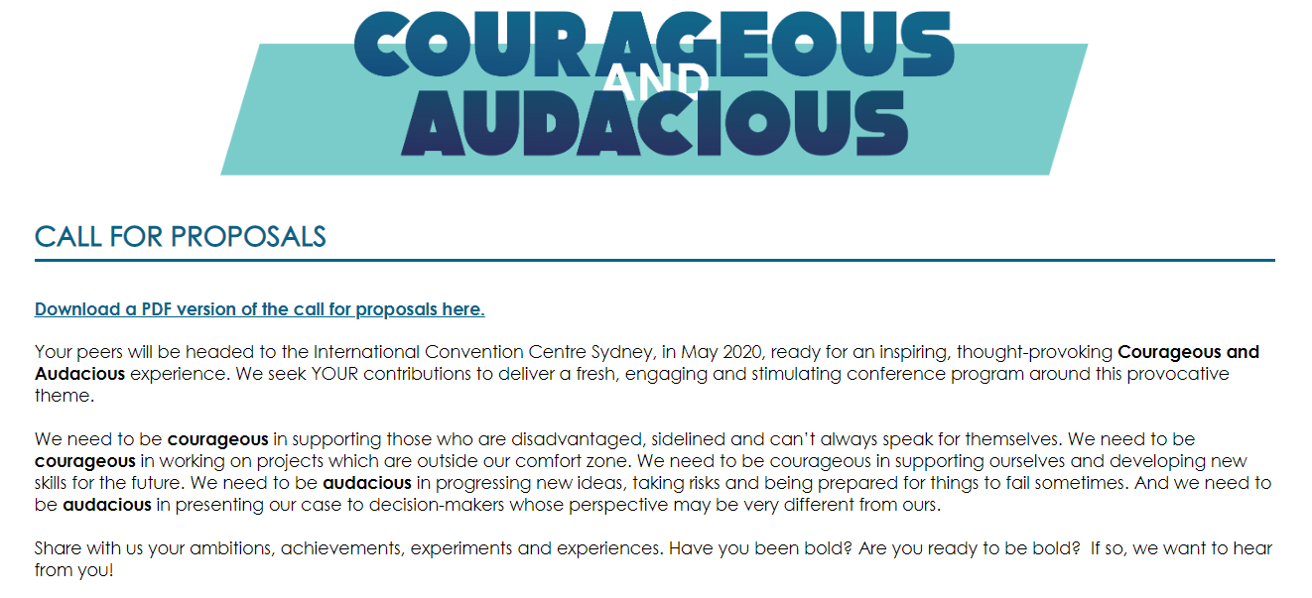

#QLDCritLib

